Slide 1





Strings and Text Processing
Processing and Manipulating Text
SoftUni Team
Technical Trainers
Software University
http://softuni.bg

Slide 2



Table of Contents
What is a String?
Manipulating Strings
Comparing, Concatenating, Searching
Extracting Substrings, Splitting
Building and Modifying Strings
Operator +

Slide 3
Questions
sli.do #python-fund

Slide 4

Strings

Slide 5
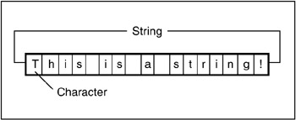
What is a String?
String objects contain an immutable (read-only) sequence of characters
Before initializing, a string variable has '' value

Slide 6


Manipulating Strings
Comparing, Concatenating, Searching, Extracting Substrings, Splitting

Slide 7
Comparing Strings
There are several ways to compare two strings
Case-sensitive:
Comparing with > and < checks the strings’ lexicographic order
Case-insensitive:
str1 < str2
str1 > str2
str1 == str2
str1 <= str2
str1.lower() < str2.lower()
str1.lower() > str2.lower()
str1.lower() == str2.lower()
str1.lower() <= str2.lower()
'alice' < 'bobby' # True (a (97) < b (98))
'alice' < 'ali' # False (second string is shorter)

Slide 8
Concatenating Strings
There are several ways to concatenate strings:
Using the join() method
Using the + or the += operators
Any object can be appended to a string using str():
str = ' '.join('hi', 'gosho') # hi gosho
result = str1 + str2 + str3
result += str1
name = "Peter"
age = 22
s = name + " " + str(age) # → "Peter 22"

Slide 9

Searching in Strings
Finding a character or substring within given string
str.find(term) – returns the index of the first occurrence
Returns -1 if there is no match
str.rfind(term) – returns the index of the last occurrence
str.find(term) and str.index(term) work identically except index() throws ValueError if the string is not found
email = "vasko@gmail.org"
first_index = email.find("@") # 5
no_index = email.find("/") # -1
verse = "To be or not to be.."
lastIndex = verse.rfind("be") # 16

Slide 10
Problem: Count Substring Occurrences
You are given a text and a pattern
Find how many times that pattern is in the text.
Overlapping is allowed
ababa caba
aba
3
aaaaaa
aa
5
Welcome to SoftUni
Java
0
Check your solution here: https://judge.softuni.bg/Contests/952/

Slide 11
Solution: Count Substring occurrences
text, lookup_text = input(), input()
occurrences, current_index = 0, 0
while current_index != -1:
current_index = text.find(lookup_text, current_index)
if current_index is not -1:
occurrences += 1
current_index += 1
print(occurrences)
starting index

Slide 12
Extracting Substrings
Getting substrings from a string, using list slicing:
str[startIndex:startIndex + length]
str[startIndex:]
filename = r"C:\Pics\Rila2005.jpg"
name = filename[8:16] # Rila2005
filename = "C:\\Pics\\Summer2009.jpg"
name_аnd_extension = filename[8:]
# name_and_extension is Summer2009.jpg
0 | 1 | 2 | 3 | 4 | 5 | 6 | 7 | 8 | 9 | 10 | 11 | 12 | 13 | 14 | 15 | 16 | 17 | 18 | 19
C | : | \ | P | i | c | s | \ | R | i | l | a | 2 | 0 | 0 | 5 | . | j | p | g

Slide 13

Splitting Strings
To split a string by given separator use the split() method
listOfBeers = "Amstel, Zagorka, Tuborg, Becks"
beers = listOfBeers.split(',')
print("Available beers are:")
for beer in beers:
print(beer)

Slide 14

Other String Operations
Replacing, Deleting Substrings, Changing Case

Slide 15
Replacing and Deleting Substrings
str.replace(match, term) – replaces all occurrences of given string with another (resulting in a new string)
Deleting (or replacing) part of a string (with list slicing):
cocktail = "Vodka + Martini + Cherry";
replaced = cocktail.replace("+", "and");
# Vodka and Martini and Cherry
some_str = 'hello(this text should be removed) there!'
some_str = some_str[:5] + some_str[-7:]
print(some_str) # hello there!

Slide 16
Problem: Text filter
You are given a text and a string of banned words
Replace all banned words in the text.
You should replace with "*", equal to the word's length
Linux, Windows
It is not Linux, it is GNU/Linux. Linux is merely the kernel, while GNU adds the functionality...
It is not *****, it is GNU/*****. ***** is merely the kernel, while GNU adds the functionality...
Check your solution here: https://judge.softuni.bg/Contests/952/

Slide 17
Solution: Text Filter
Using str.replace() to filter text:
banned_words = input().split(', ')
text = input()
for word in banned_words:
text = text.replace(word, '*' * len(word))
print(text)

Slide 18
Changing Character Casing
Using the various case changing methods:
text = "on GREEN Dolphin Straße"
lowercase = text.lower() # on green dolphin straße
uppercase = text.upper() # ON GREEN DOLPHIN STRASSE
titlecase = text.title() # On Green Dolphin Straße
capital = text.capitalize() # On green dolphin straße
casefold = text.casefold() # on green dolphin strasse
caseswap = text.swapcase() # ON green dOLPHIN sTRASSE

Slide 19
Trimming White Space
str.strip() – trims whitespaces at start and end of string
str.strip(chars)
str.lstrip() and str.rstrip()
s = " example of white space "
clean = s.strip()
print(clean) # "example of white space"
s = " \t\nHello!!! \n"
clean = s.strip(' ', ',' ,'!', '\n', '\t')
print(clean) # "Hello"
s = " C# "
clean = s.lstrip() # "C# "

Slide 20

String Operations
Exercises in class

Slide 21
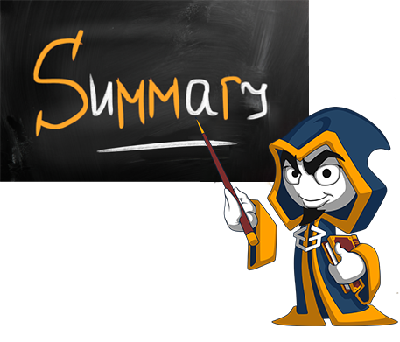
Summary
Strings are immutable sequences of characters
Changes to the string creates a new object, instead of modifying the old one
Comparing strings using ==, <, > operators
Replacing, deleting substrings
Case methods

Slide 22






SoftUni Diamond Partners

Slide 23






SoftUni Diamond Partners

Slide 24







Strings and Text Processing
https://softuni.bg/courses/

Slide 25

License
This course (slides, examples, demos, videos, homework, etc.) is licensed under the "Creative Commons Attribution-NonCommercial-ShareAlike 4.0 International" license

Slide 26




Trainings @ Software University (SoftUni)
Software University – High-Quality Education, Profession and Job for Software Developers
softuni.bg
Software University Foundation
http://softuni.foundation/
Software University @ Facebook
facebook.com/SoftwareUniversity
Software University Forums
forum.softuni.bg

